Slide 1

Department of Information Technology
Chandubhai S. Patel Institute of Technology
Dataplatform for SundayPyjamas
Presented By :
15IT014:Tejaswi Chaudhary (PID:008)
15IT058:Sneh Naik (PID:001)
15IT064:Prarthan Pandya (PID:001)
Guided By :
Dr. Amit Thakkar
Prof. Ravi Patel
External guide :
Sagar Agrawal
Notes:
1

Slide 2
Content
Project Definition
Summary of the work done
Scope and Objective
Hardware and Software Requirements
Diagrams
Functionalities
Conclusion
Future Enhancements

Slide 3
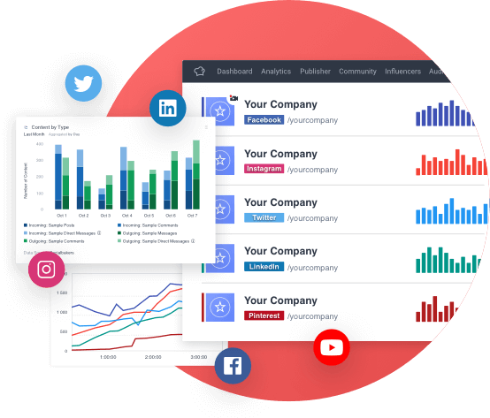
Project Definition
Tracking of posts & profile.
Scheduling for profile posts.
To Grow social media presence.
For Business or individual use.
Schedule to multiple platform.
Measure the ROI of your work.

Slide 4
Scope
The platform schedules posts – Image, Text, Video
The platform generates report – For post and Profile
Platform DOES NOT run algorithms
Can be used on limited social media platforms

Slide 5
Objective
Designed to reduce efforts and complexity
Designed to automate things
Designed for a better user experience
Designed for simplicity
Designed for performance tracking
Designed to increase the social media presence
Allows users to generate a report to compare

Slide 6
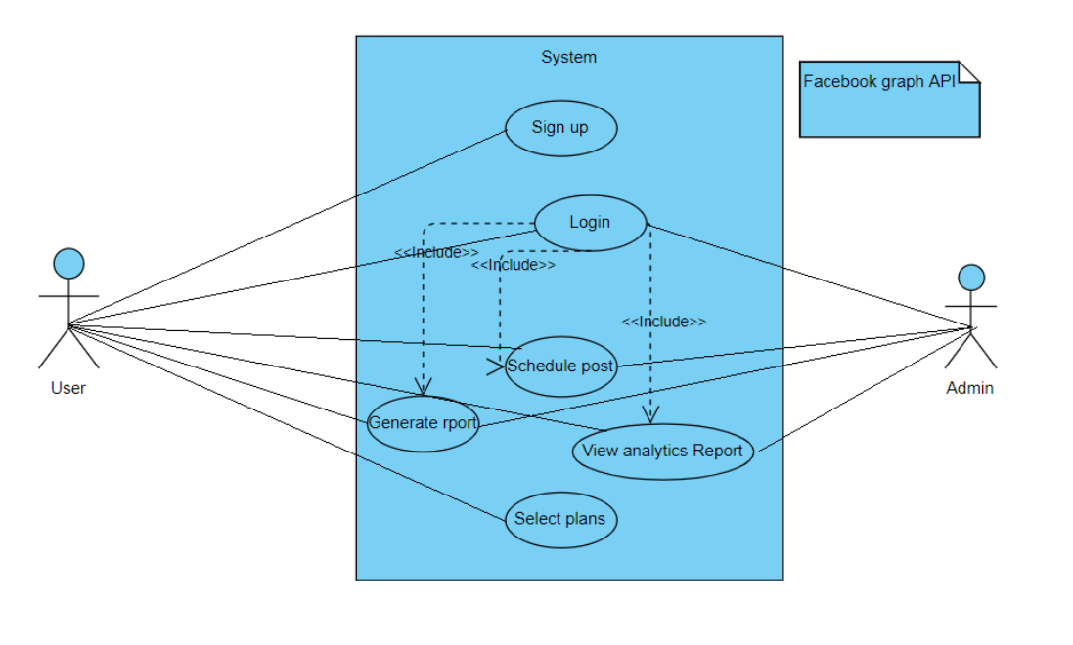
Use Case Diagram

Slide 7
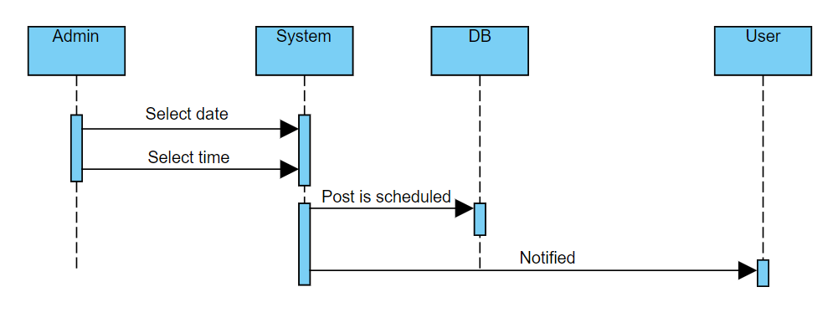
Sequence Diagram-Scheduling a Post

Slide 8
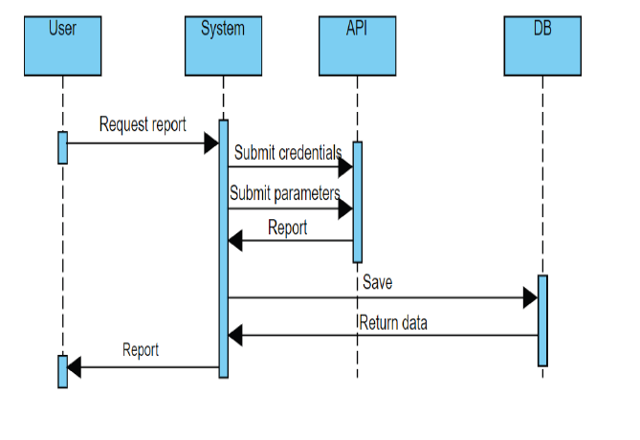
Sequence Diagram-Generate Report

Slide 9
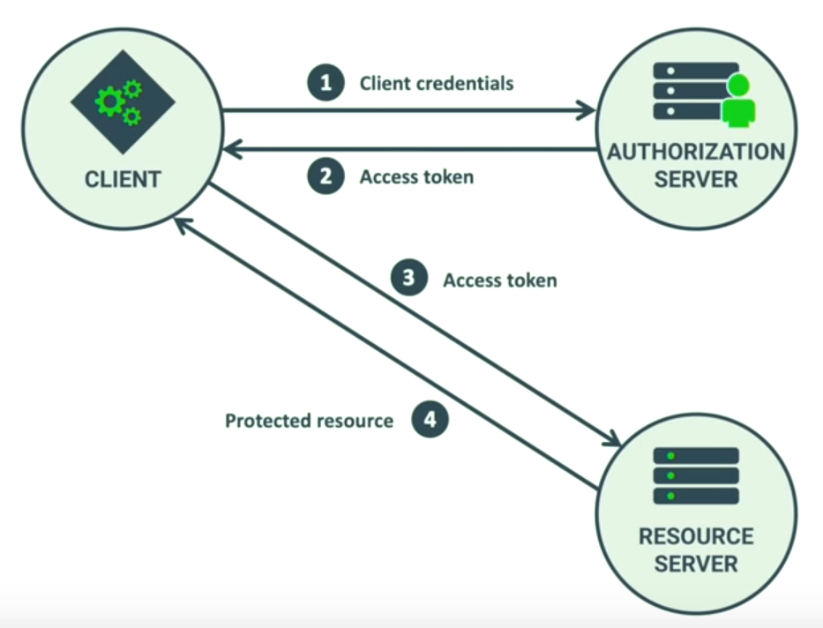
Client credentials grants from FACEBOOK

Slide 10
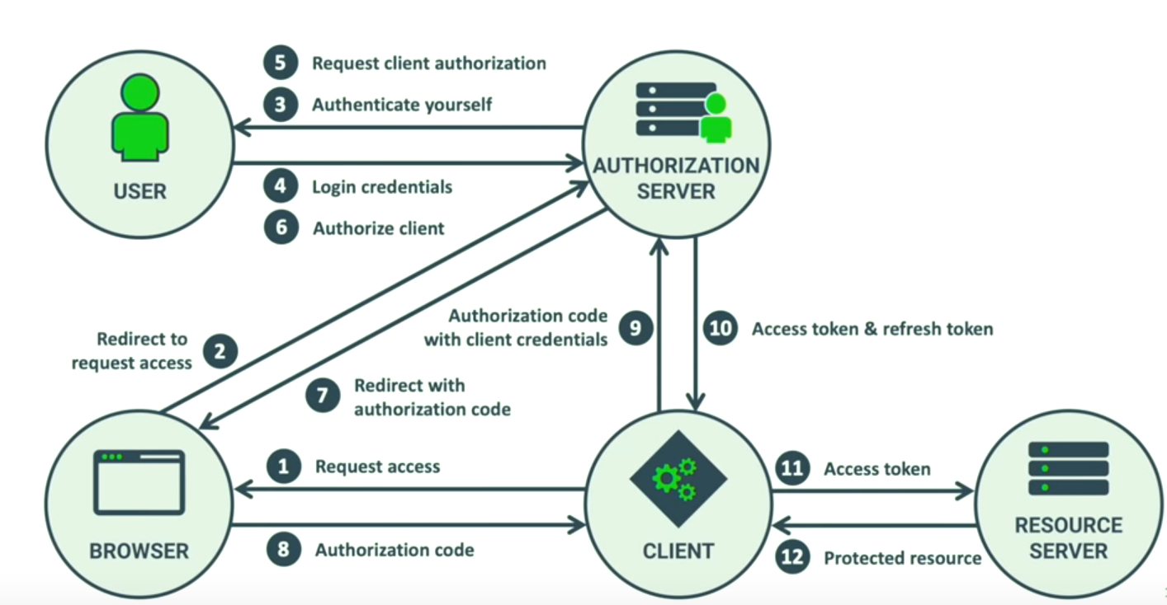
Authorization and authentication of current application

Slide 11
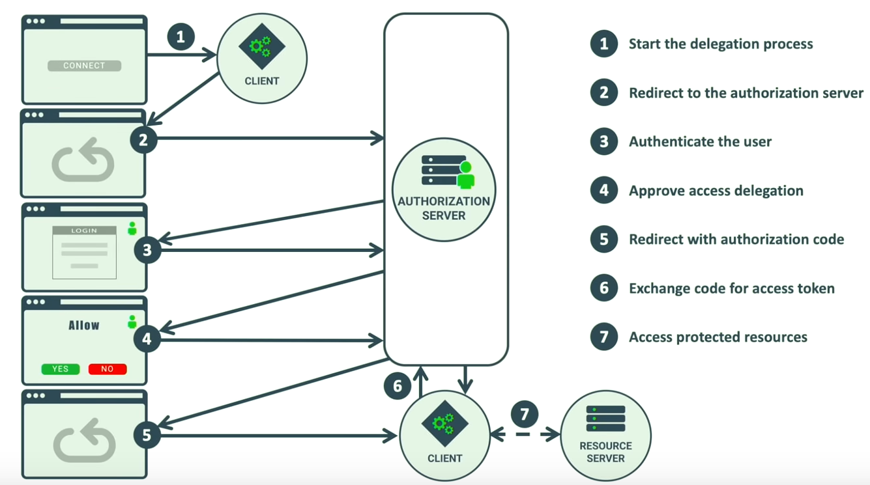
Frontend authentication flow

Slide 12
Future Enhancements
Searching for influencers will be added in future
Payment gateway integration will be done in the future
Features like search via #Hashtags will be added in future.
More optimization can be done for the mobile application for the different
modules.
Advertisements can be shown to particular users by their behaviour on the
website.
Combine the current project with some other ongoing projects for security
purpose.

Slide 13
Thank You

